Slide 1


[
DESIGN THINKING AND INNOVATION
Presented by
K.SANDEEP BABU---23KD1A0257
D.RESHMA---23KD1A0232
K.BHAVANI---23KD1A0254
B.LEELA JYOSTHNA---23KD1A0211

Slide 2
SOLAR POWER IRRIGATION SYSTEM
UNDER THE GUIDENCE OF:
Mr.B.Ram vara prasad,
(ph.Assistatant professor,
Department of EEE,LIET)

Slide 3

CONTENTS
INTRODUCTION TO DESIGN THINKING
PROBLEM STATEMENT
EMPATHY
DEFINE
IDEATE
PROTOTYPE
WORKING OF PROTOTYPE
CONCLUTION

Slide 4
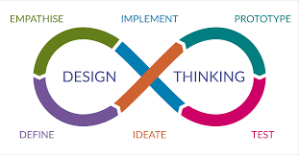
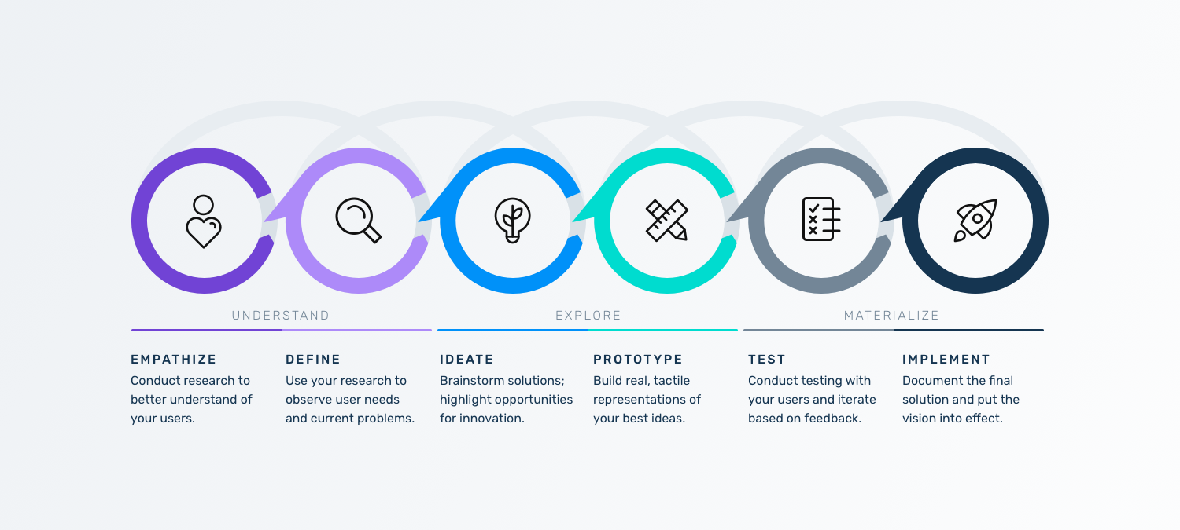
Design thinking is a human-centered approach to problem-solving that focuses on understanding users' needs, generating creative solutions, and iteratively testing them.
It's a process of empathy, ideation, prototyping, and testing, aiming to create innovative solutions that meet real user needs and improve the user experience
What is meant by design thinking and innovation ?

Slide 5

PROBLEM STATEMENT
Manual irrigation system are labour intensive and often inefficient , leading to water waste &reduced to crop yield

Slide 6

Human-Centered Empathy
Farmers' livelihoods: Many smallholder farmers struggle with the costs and unreliability of fuel-based pumps or limited access to grid electricity. Solar irrigation offers a clean, cost-effective, and reliable alternative.
Daily struggles: Understanding that a farmer wakes before dawn and hauls water manually, or waits anxiously for rains that don’t come, puts solar irrigation into perspective—not as a luxury, but a tool of liberation.
Women and children: In many regions, women and kids are tasked with fetching water. Solar irrigation can free up their time for education, rest, or additional income-generating activities.
Environmental Empathy
Sustainability: Solar-powered pumps reduce reliance on diesel and grid power, cutting carbon emissions and air pollution.
Water use awareness: With solar irrigation, water becomes more accessible, but it's important to design systems with empathy for future generations—avoiding over-extraction from aquifers.
Social Empathy
Community upliftment: Empathizing with entire communities means recognizing that one solar pump might transform a village—boosting crop yields, food security, and even schooling rates.
Equity: A solar system can create disparities if only a few can afford it. Designing for access—through cooperatives, subsidies, or microfinancing
EMPATHY:

Slide 7

DEFINE
With advancements in technology, the systems can be made more user-friendly. You can control the motor pump from a remote location using your mobile phone. You can get water level indication of the reservoir and overhead storage tank on your mobile phone. These technologies are already available in the market, though presently they are not so popular

Slide 8
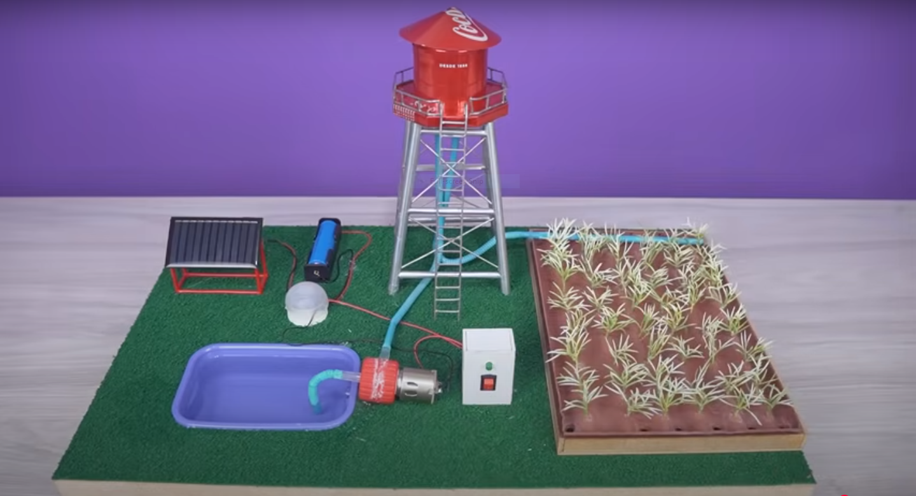
PROTOTYPE

Slide 9
WORKING OF PROTOTYPE
In this the solar energy is taken input for the solar panel and that panel converts into electrical energy.
That electrical energy is stored in the battery.
We are using TP4056A module charging for storing and using electrical power.
The motor is used to pump the water from pond/lake to the field.
In this the solar power is gets converted into electrical energy energy and that energy is used to run the motar which transfer water to fields

Slide 10

ADVANTAGES
1. It makes irrigation possible in remote areas 2. Is environment friendly 3. No grid connection is required 4. No electricity bills to be paid 5. No fuel is required 6. Is durable, requiring minimal maintenance

Slide 11
CONCLUTION
The overall conclusion is that solar power Irrigation system reduced cost for water pumping also work durable and increases lift of the system with minimum cost. As irrigation system is modernized for pressurized irrigation, with the help of solar power which decreases cost as compared to diesel and electricity form grid. So farmers, as well as government, should focus on Solar energy

Slide 12

Thank You

